Slide 1
Yichun City： An ecotourism gem in northern China
The green pearl of the Northeast

Slide 2
Catalog
5
4
3
Winter
Autumn
2
Summer
1
Spring
Location

Slide 3
Location of the city of Yichun
Geographical location

Slide 4
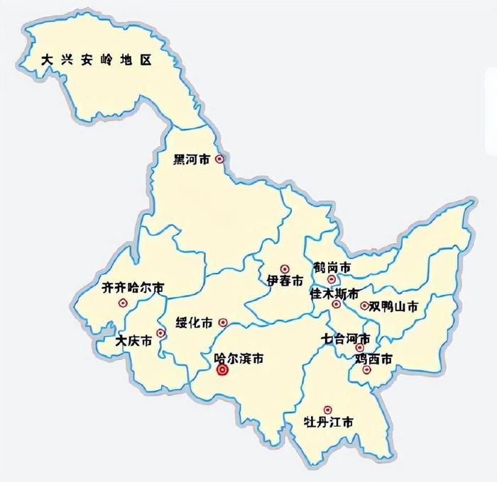
geographical location
Yichun, a city located in the northeast of Heilongjiang Province, is known as the "Forest Capital." Its beautiful scenery and pleasant views are like a stunning painting.
The vast forests, wetlands, and ice and snow all contribute to this breathtaking landscape.

Slide 5
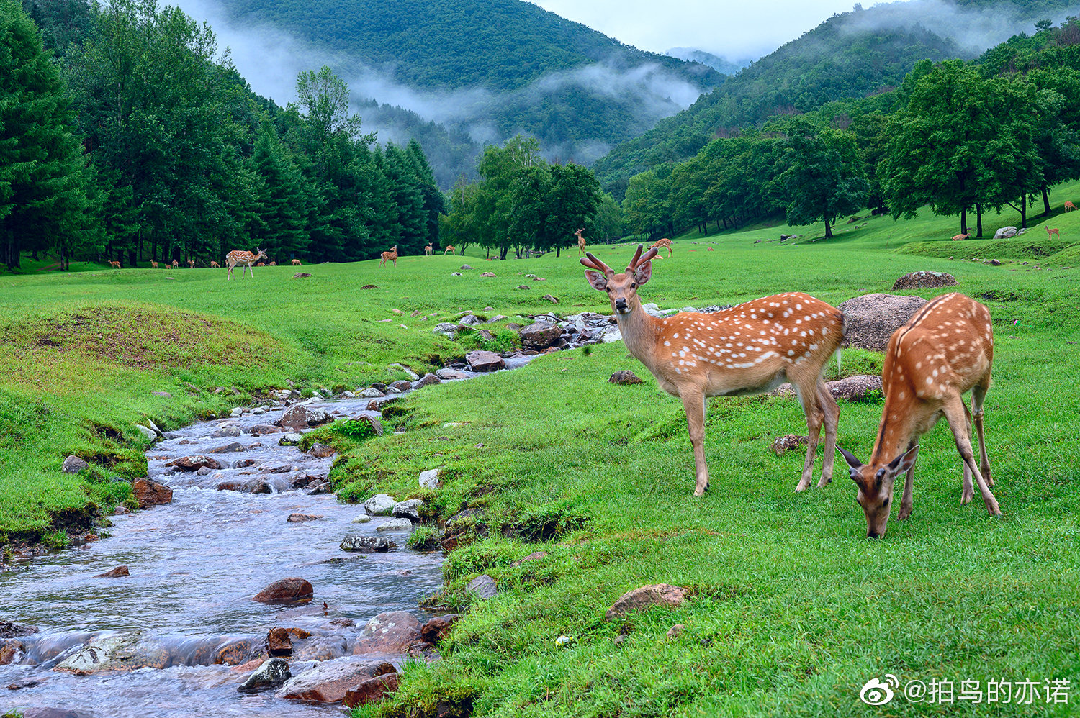

Spring in the city of Yichun
Spring is full of vitality and vitality. Everything comes back to life with lush greenery.

Slide 6
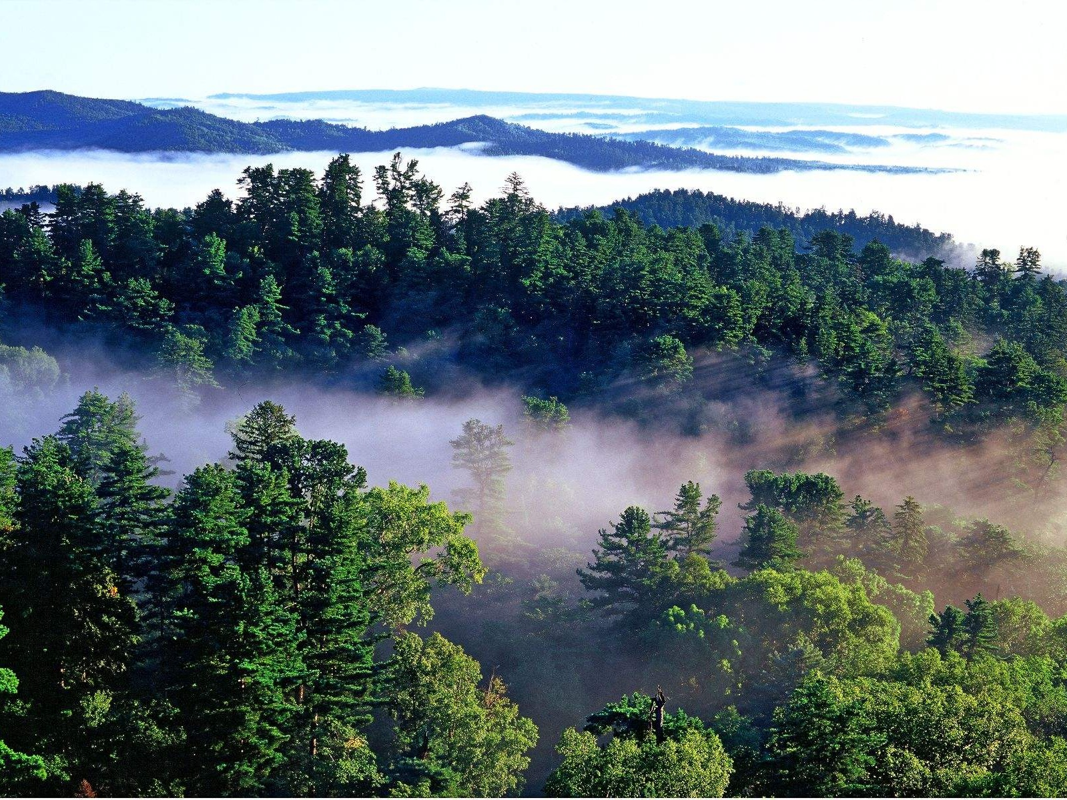
Spring
The forests of Yichun put on a new dress, with the fresh green leaves contrasting with the blue sky.
The headwaters of the Songhua River gurgle gently, bringing vitality to the land.

Slide 7
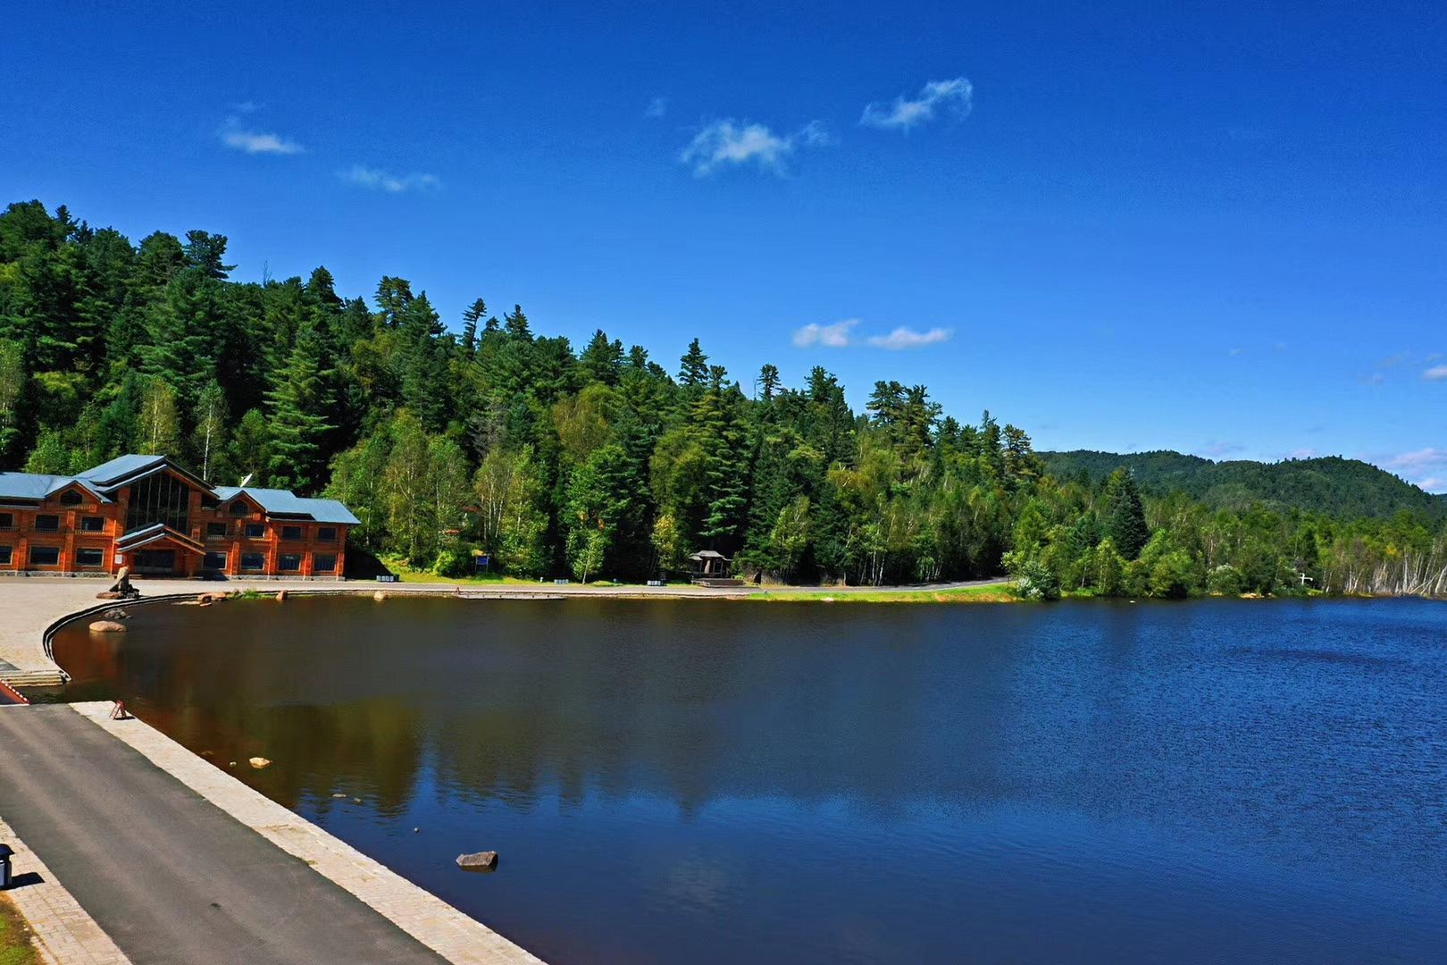
Summer in the city of Yichun
Yichun becomes a summer retreat. The endless sea of trees provides natural coolness, shading the sky.

Slide 8
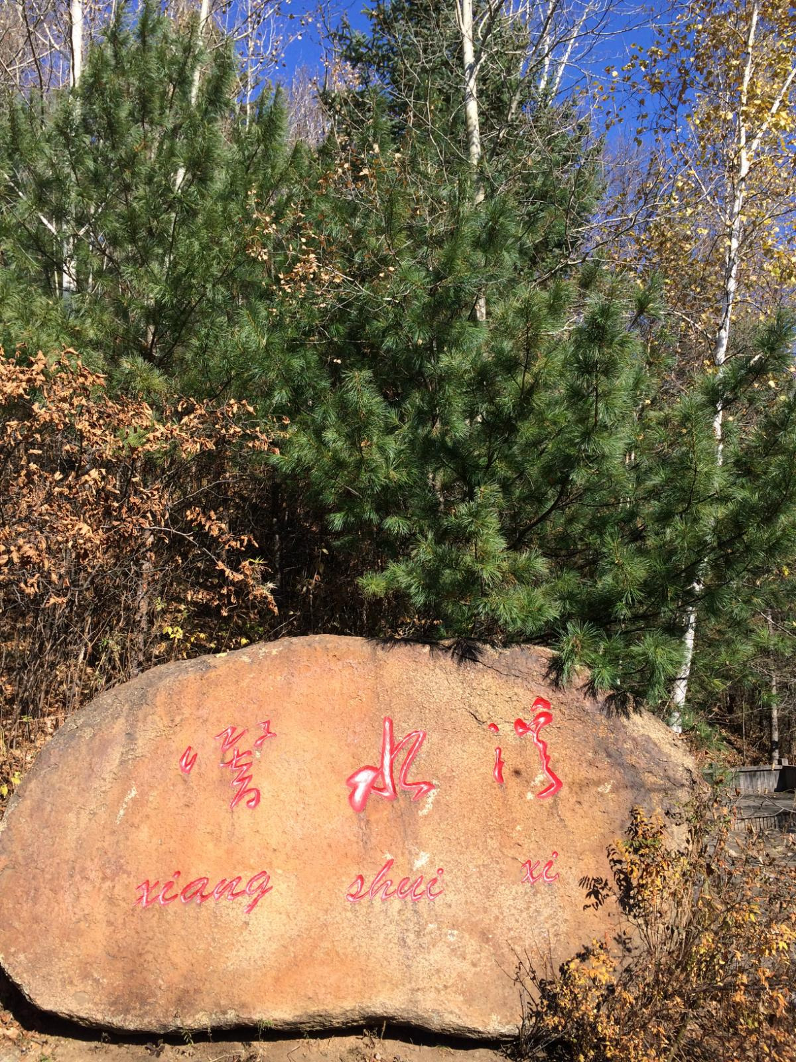
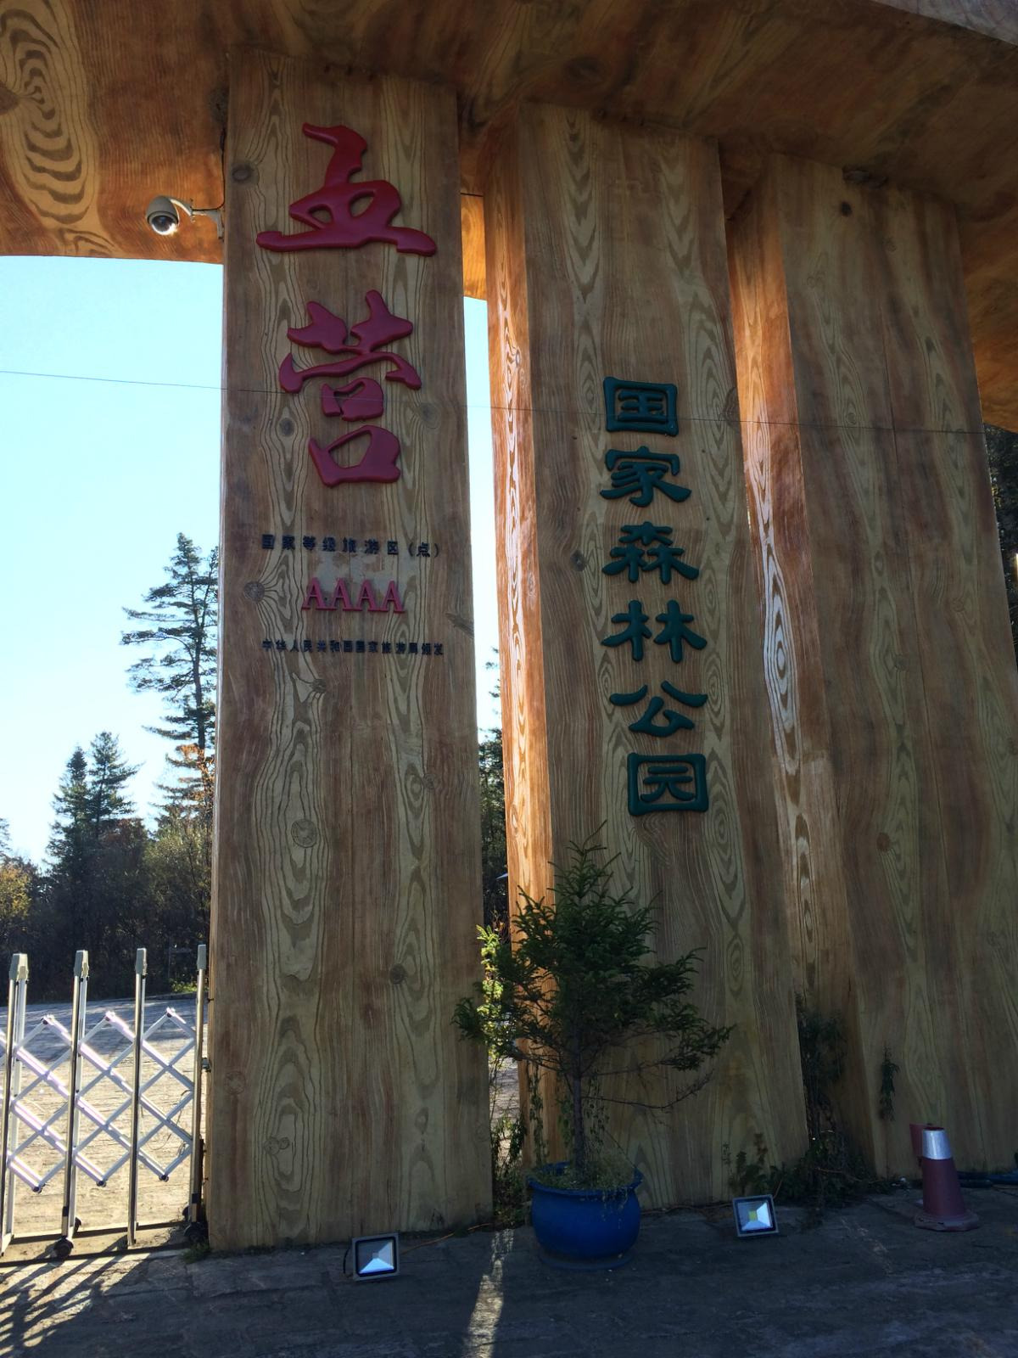
Summer
In the Wuying National Forest Park, the rich oxygen ions and fresh air make it hard for visitors to leave.

Slide 9
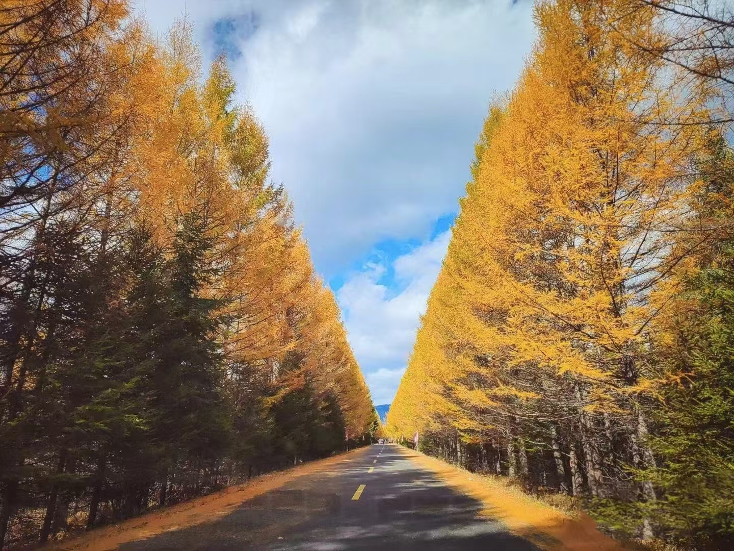
Autumn in the city of Yichun
The forests are painted in vibrant colors, and the mountains are a riot of hues.

Slide 10
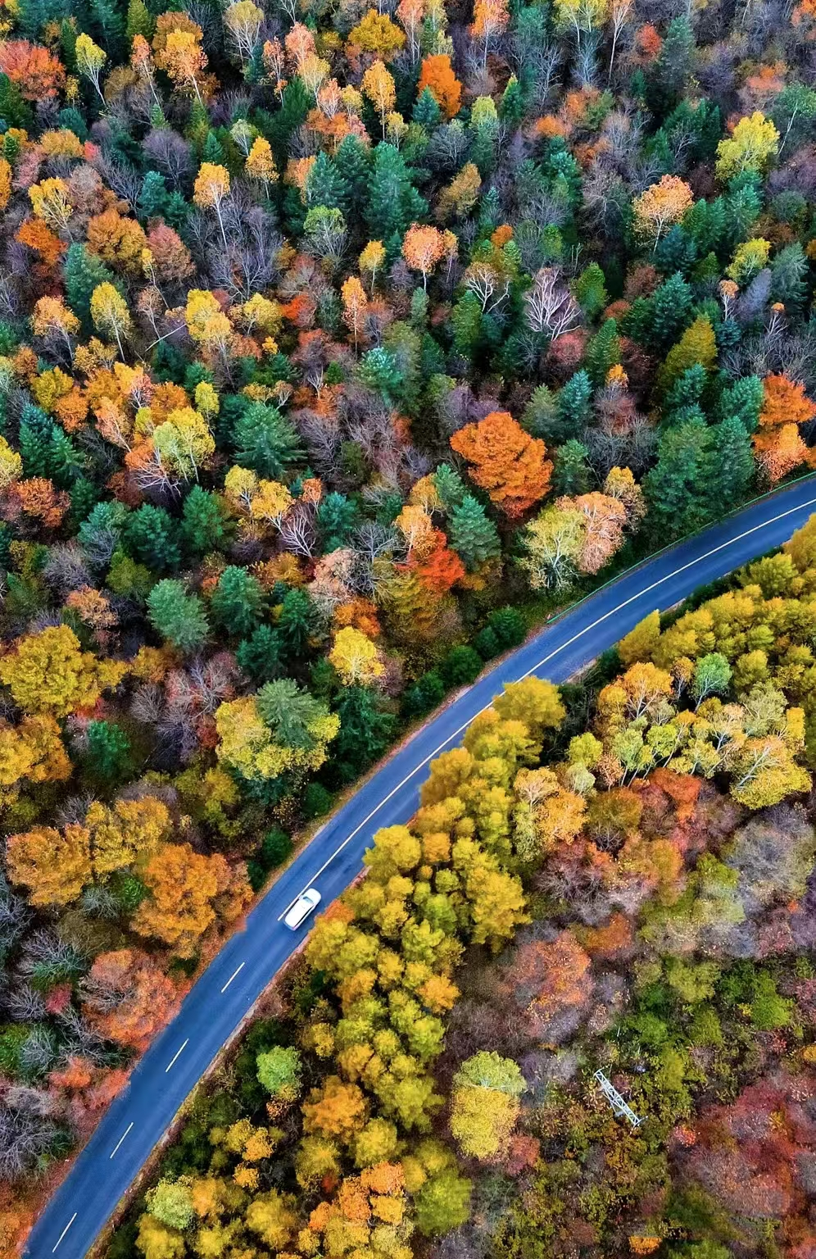
Autumn
It's the harvest season, with abundant fruits in the picking gardens, filled with laughter and joy.

Slide 11
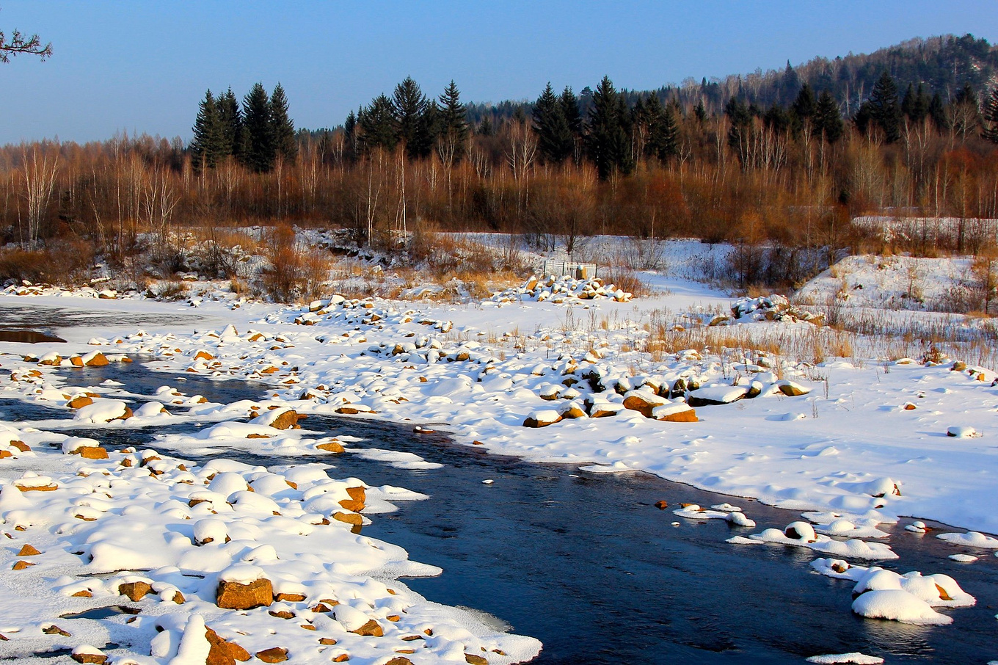
Winter in the city of Yichun
Everything is covered in white, looking very beautiful.

Slide 12
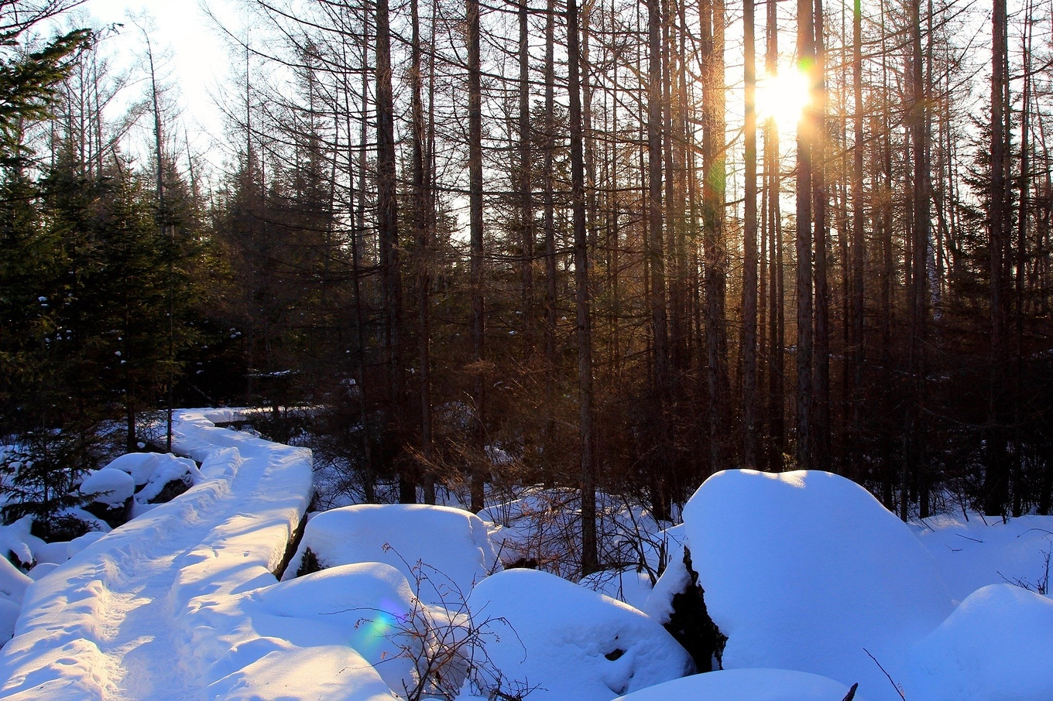
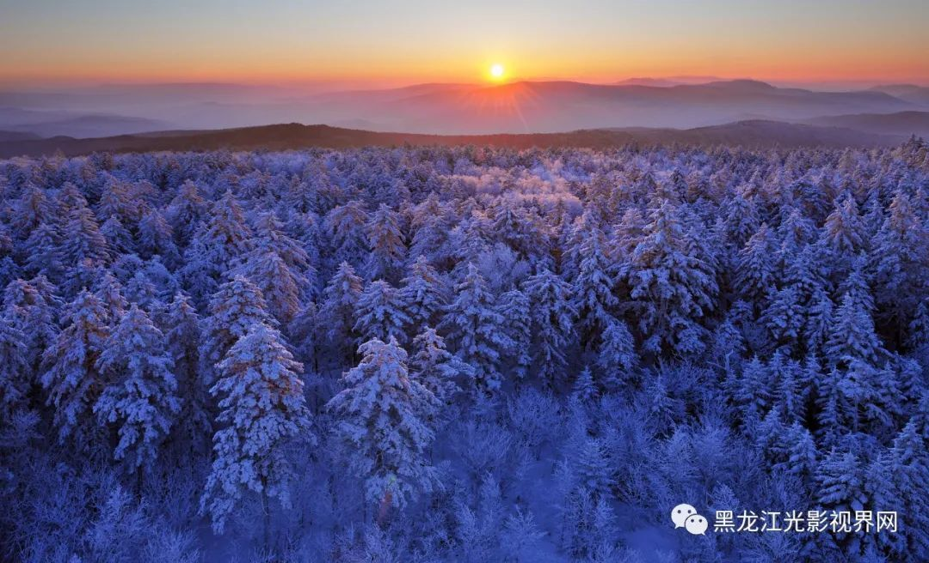
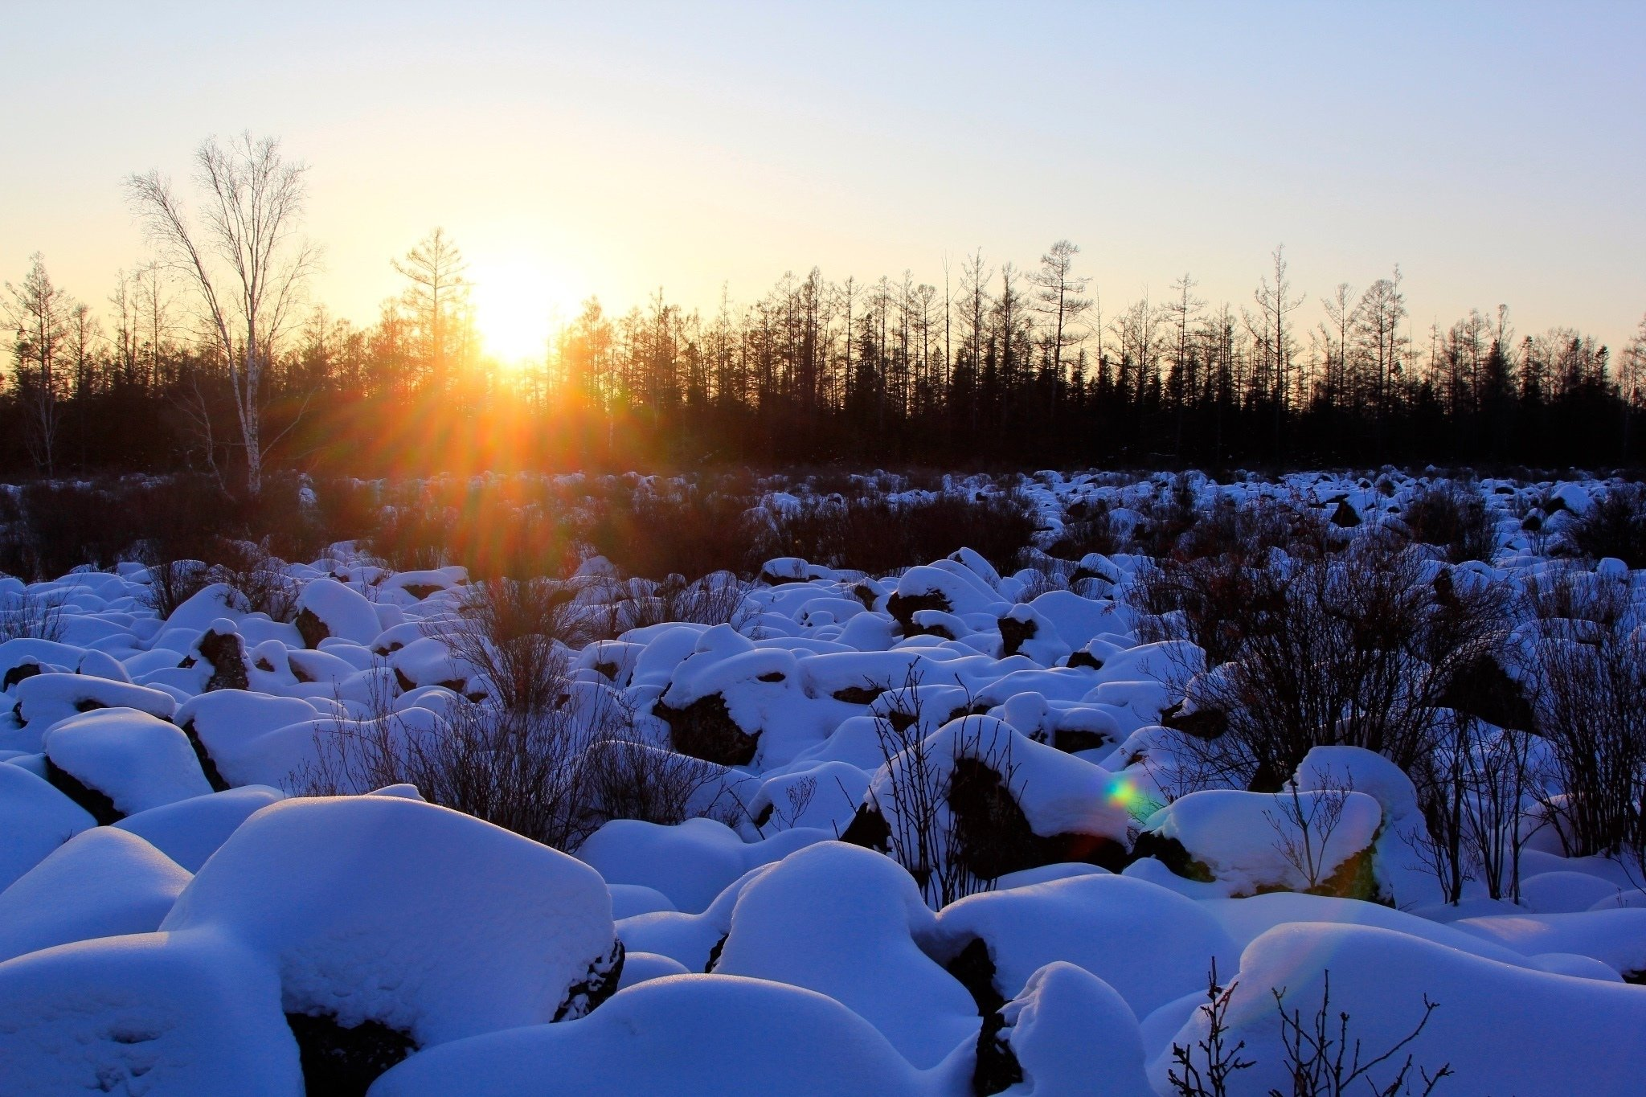
Winter
Yichun's winter wonderland attracts many visitors to enjoy the snow and go skiing.
The Kuerbin rime and the volcanic landscape of Hongxing are paradises for photography enthusiasts.

Slide 13
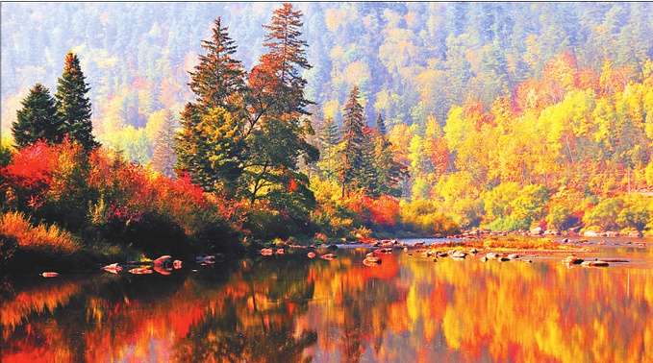
The best time to visit
If you're planning a visit to Yichun, I highly recommend choosing autumn. At this time, the Wuhua Mountain in Yichun is colorful, full of red leaves, and the forests are dyed, like a beautiful picture. With a pleasant climate and excellent air quality, it is an ideal place for photography enthusiasts and nature seekers. Autumn Yichun will definitely make you linger.

Slide 14
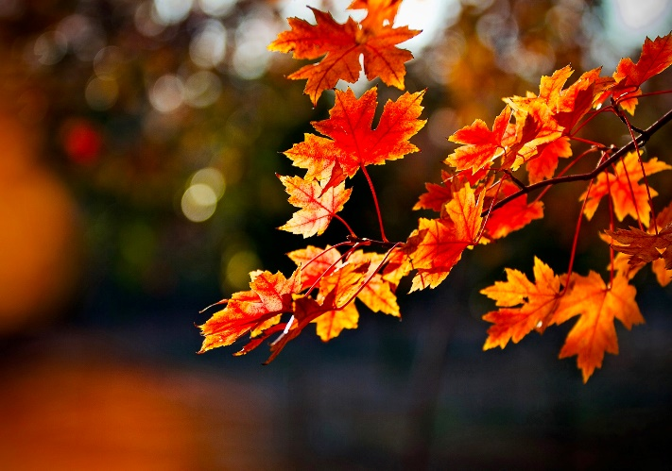
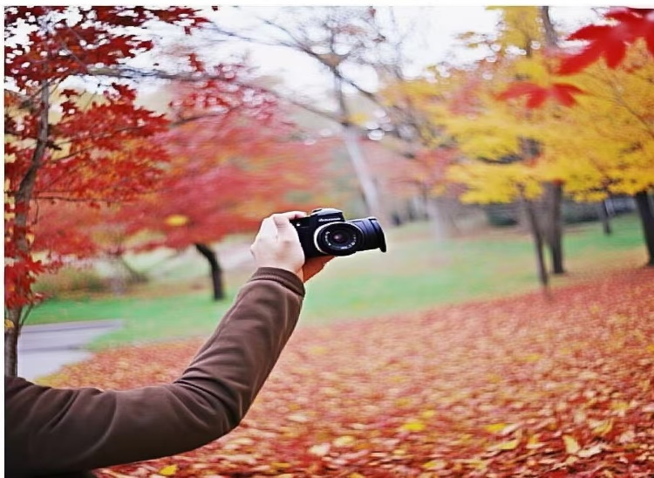
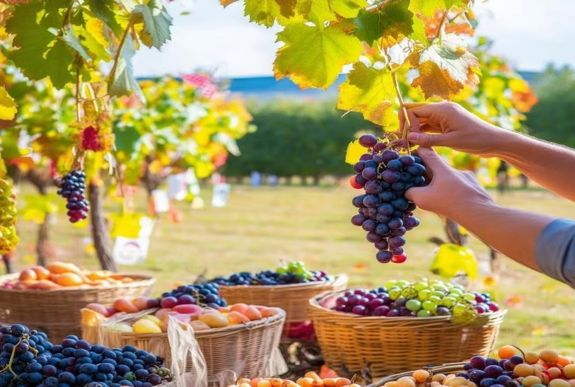
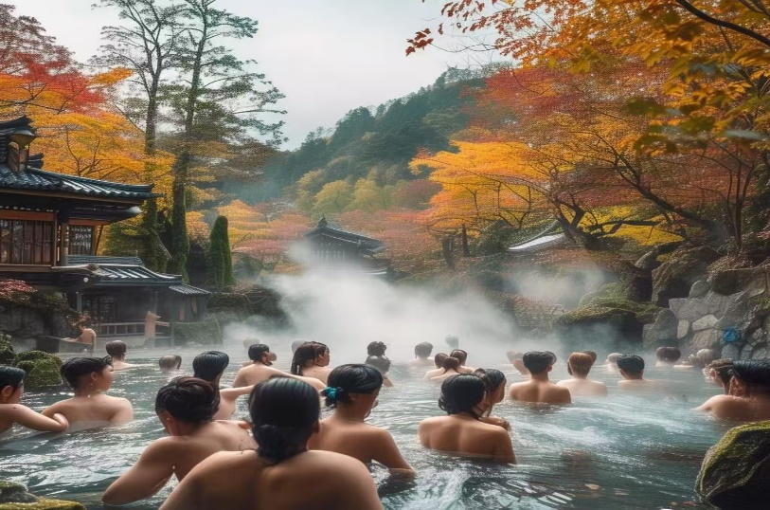
Featured Events
Autumn foliage: Autumn is the best time to enjoy the autumn leaves, so you can enjoy the colorful autumn foliage at scenic spots such as Gokayama.
Photography: For photography enthusiasts, the colors and light of autumn are a great time to capture natural scenery and portraits.
Picking experience: Autumn is the harvest season, and you can participate in fruit picking activities such as apples, pears, and grapes.
Hot spring vacations: Soak in the warm hot springs in the cool weather of autumn is a great way to relax.

Slide 15
Step onto this magical land, and it will surely impress you.

